Slide 1
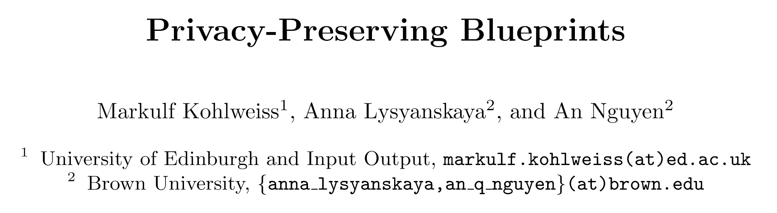
EUROCRYPT 2023
刘钰琳
2024.12.20

Slide 2
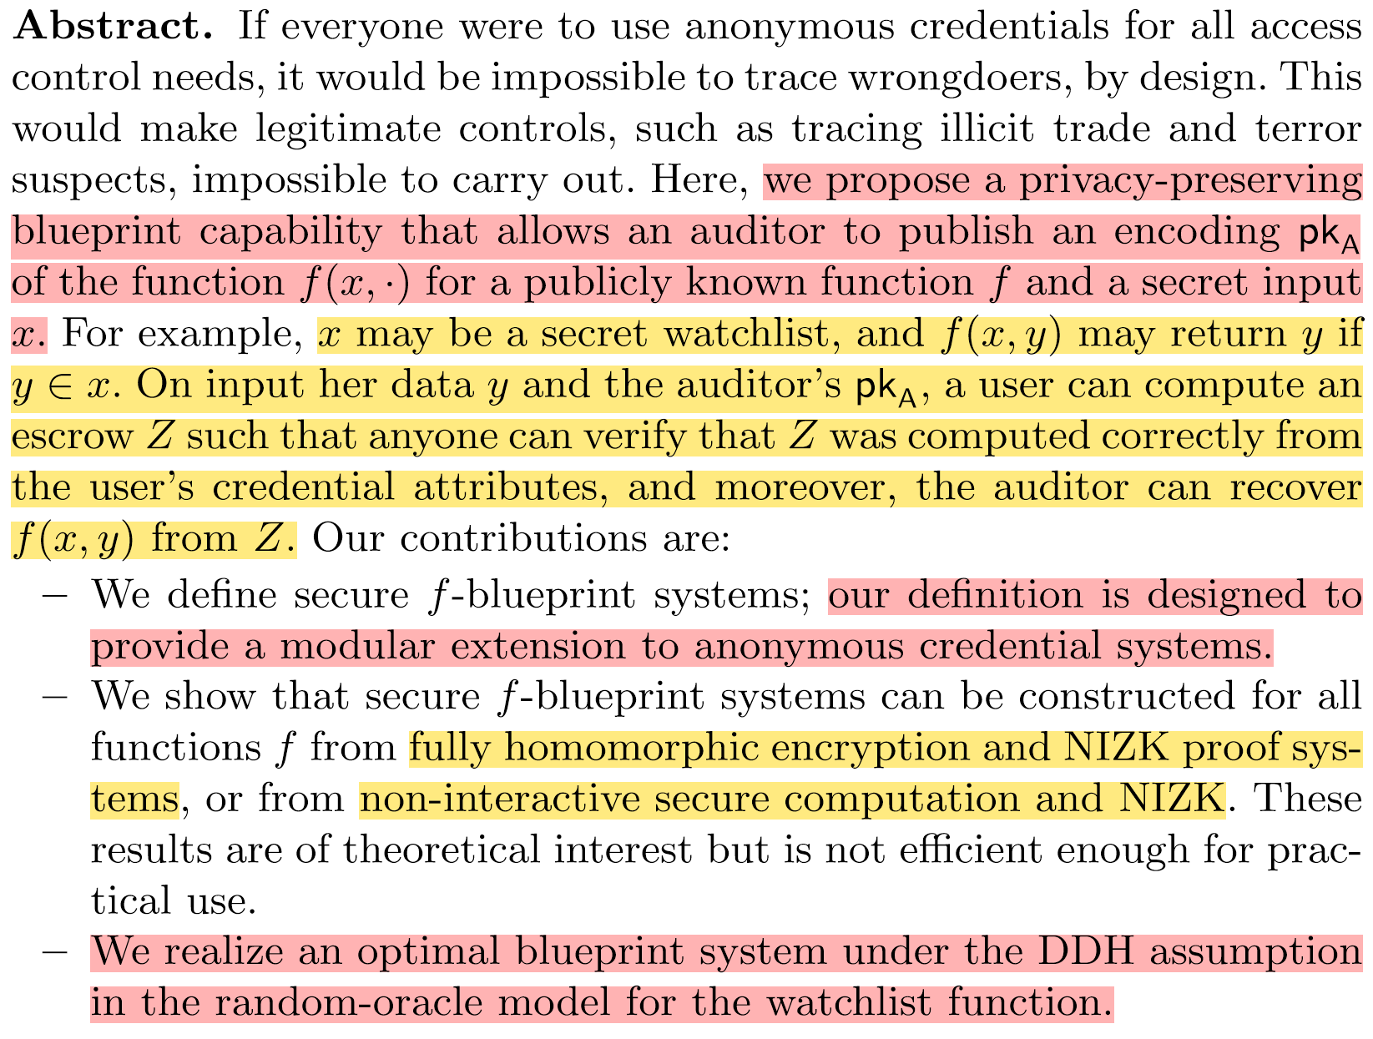
Abstract

Slide 3
Content
Introduction and Contributions
Preliminaries
Homomorphic Enough Encryption
f -Blueprint

Slide 4
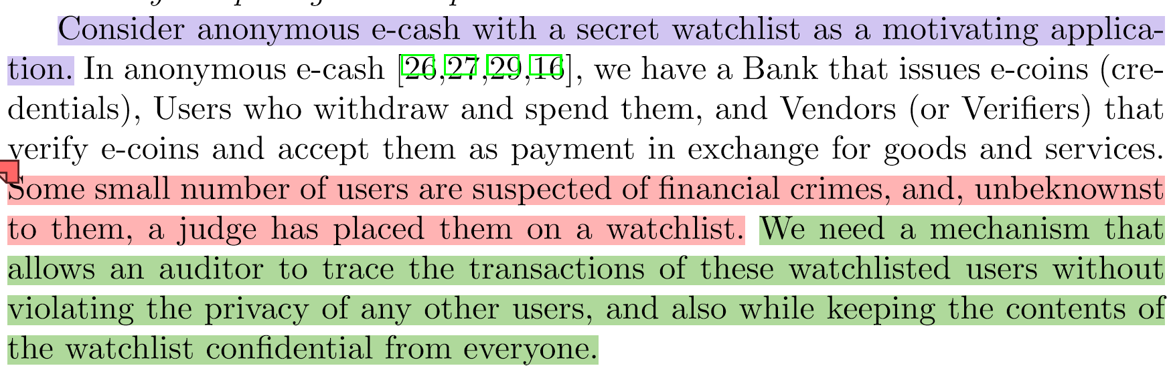
Introduction
考虑使用秘密监视列表的匿名电子现金场景：
一些少数用户涉嫌金融犯罪，在他们不知情的情况下，法官已将他们列入观察名单。
需构建一个机制，该机制旨在确保审计员能够追溯被特定监视列表收录用户的交易活动，同时避免侵犯未涉及用户的个人隐私。此外，该机制还需确保监视列表内容的机密性。

Slide 5






Introduction
Authority
Verifier
User

Slide 6

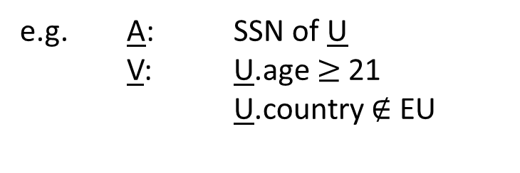


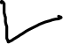

Goal
Only I know x;
e.g. suspects list
Auditor
My attributes are y.
I need V’s service.
I can only interact with U if A sees f(x,y) and P(y) holds.
Verifier
User
e.g. A: SSN of U
V: U.age $≥$ 21
U.country $∉$ EU
Notes:
The verifier’s job is to verify the escrow Z against C using VerEscrow and only let the transaction go through if, indeed, it verifies.
the user and the verifier have agreed on a cryptographic commitment C such that (1) the user is in possession of the opening of C; and (2) the transaction that just occurred guarantees that the opening of C contains user data y that is relevant for the auditor’s needs. For example, imagine that x is a watchlist consisting of names of individuals of interest, and y contains a user’s name; then this user is of interest to the auditor if y ∈ x.

Slide 7
Goal
Only I know x; I only see
f(x,y).
Auditor
My attributes are y.
I need V’s service.
I only see f.
I accept that A sees f( x , y).
I can only interact with U if A sees f(x,y). I only see f.
Verifier
User

Slide 8
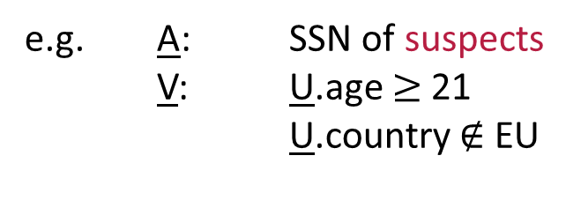
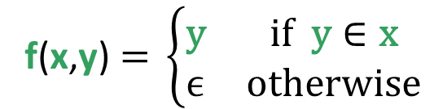
Goal
Only I know x = {y₁,… y_{n}};
y_{i} = SSN of i^{th} suspect I only see f(x,y).
Auditor
f(x,y)$\text{= }\left\{\begin{matrix}\text{y} & \text{if} \text{y}∈\text{x} \\ \text{ϵ} & \text{otherwise}\end{matrix}\right.$
My attributes are y.
I need V’s service.
I only see f.
I accept that A sees f( x , y).
Verifier
User
e.g. A: SSN of suspects
V: U.age $≥$ 21
U.country $∉$ EU

Slide 9
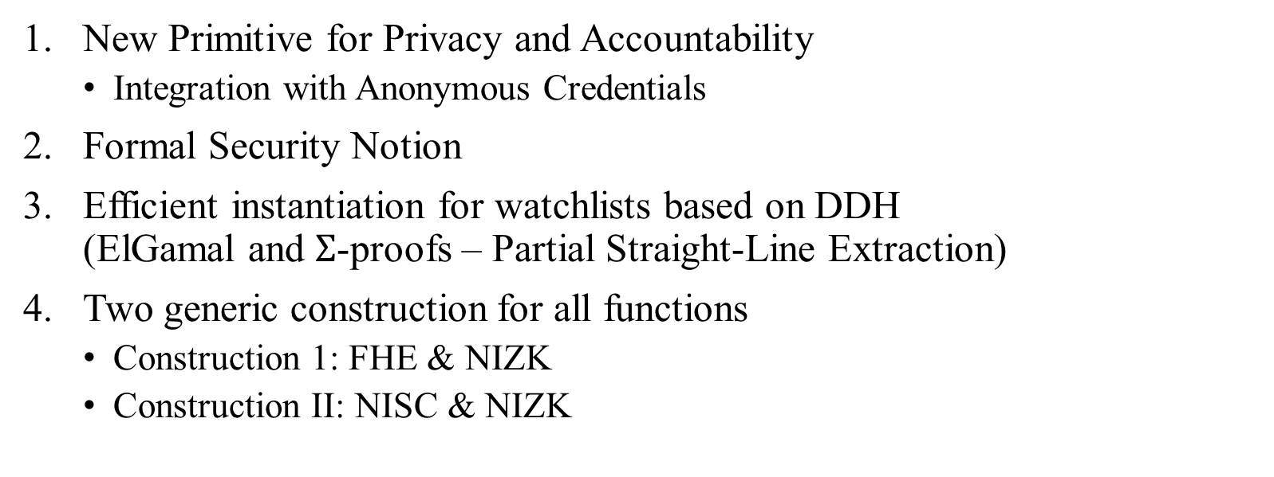
Contribution
New Primitive for Privacy and Accountability
Integration with Anonymous Credentials
Formal Security Notion
Efficient instantiation for watchlists based on DDH (ElGamal and $Σ$-proofs – Partial Straight-Line Extraction)
Two generic construction for all functions
Construction 1: FHE & NIZK
Construction II: NISC & NIZK

Slide 10
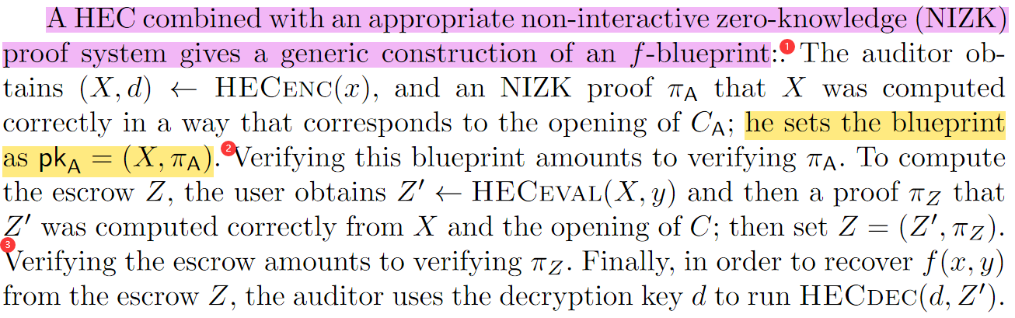
Technical roadmap
Homomorphic enough cryptosystem for the function f + NIZK = f-blueprint

Slide 11
Content
Introduction and Contributions
Preliminaries
Homomorphic Enough Encryption
f -Blueprint

Slide 12
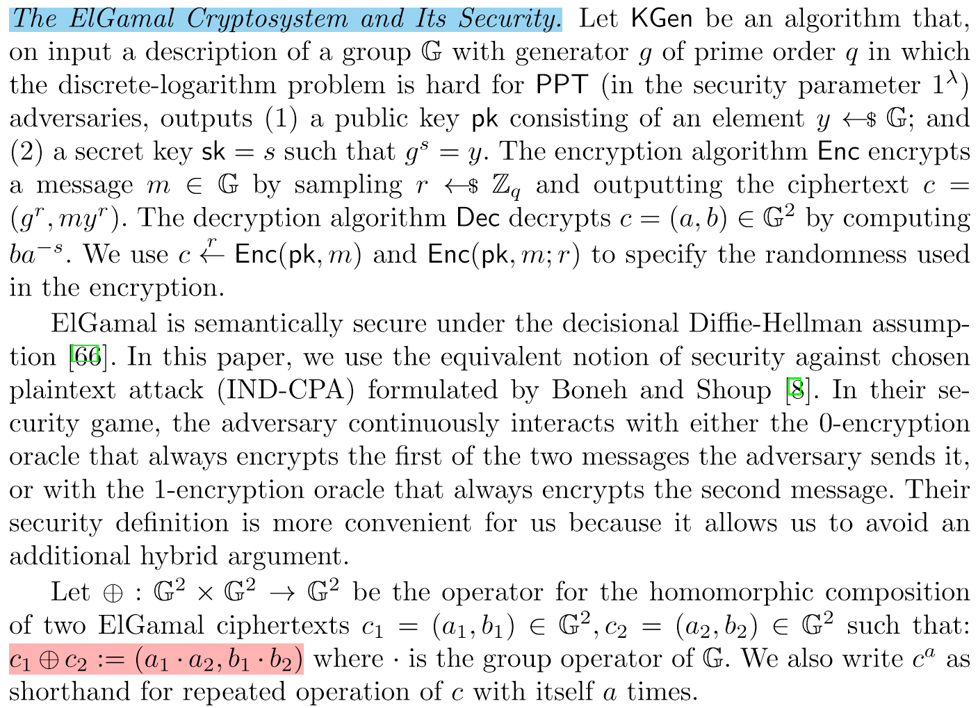
Preliminaries

Slide 13
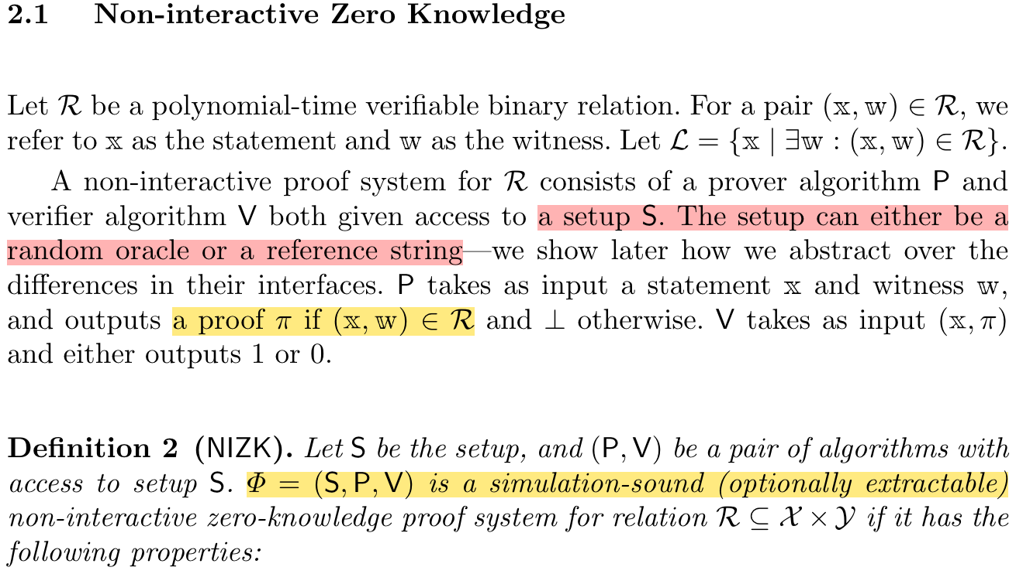
Preliminaries
Completeness
Soundness
Zero-knowledge

Slide 14
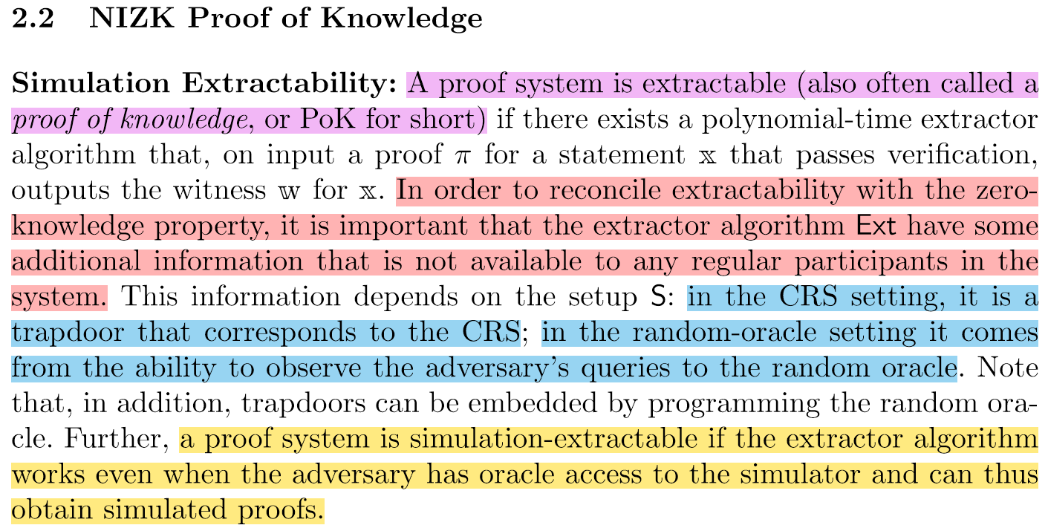
Preliminaries

Slide 15
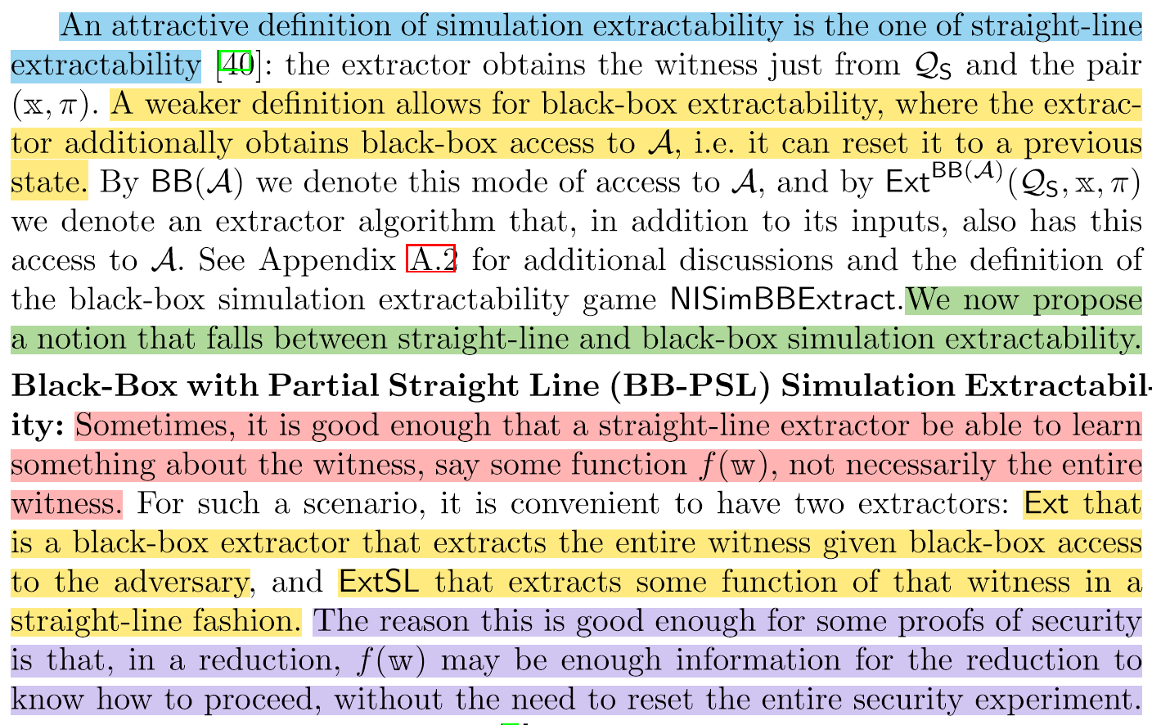
Preliminaries
Notes:
Q_S denotes the setup query tape that records the queries, replies, and embedded trapdoors of the simulated setup

Slide 16
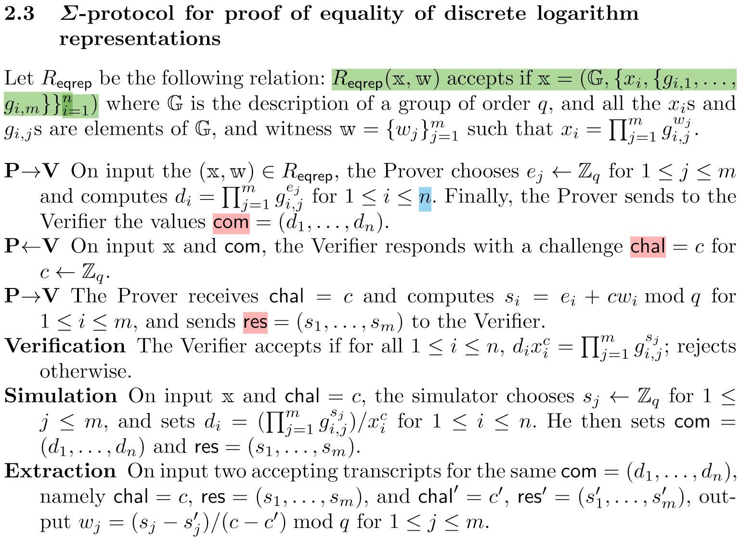
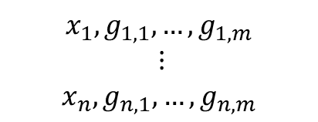
Preliminaries
$$x_{1}, g_{1,1},…,g_{1,m}$$
$$⋮$$
$$x_{n},g_{n,1},…,g_{n,m}$$
com大小取决的等式个数
res大小取决的证据个数
From Σ-protocols to BB simulation extractable NIZK PoK via Fiat-Shamir

Slide 17
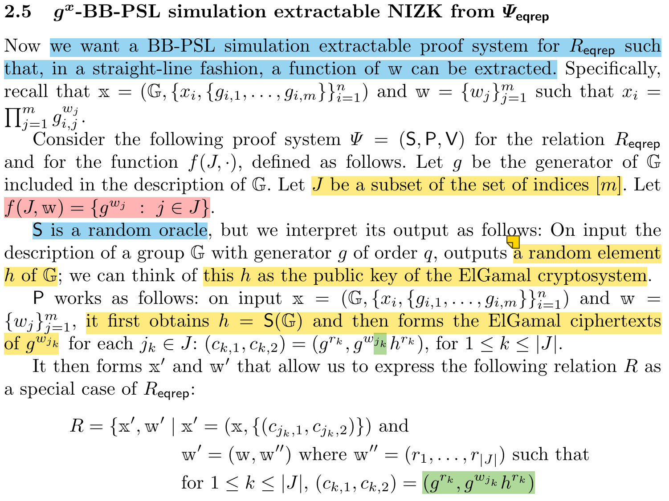
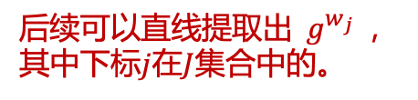
Preliminaries
后续可以直线提取出$g^{w_{j}}$，其中下标$j$在$J$集合中的。
encrypting the partial witness to the sky.

Slide 18
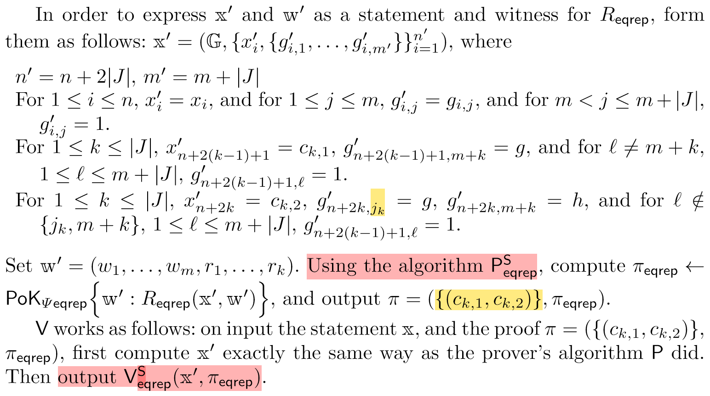
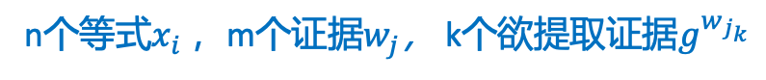


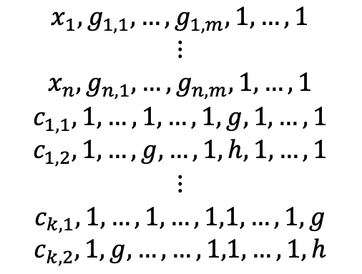
Preliminaries
n个等式$x_{i}$，m个证据$w_{j}$， k个欲提取证据$g^{w_{j_{k}}}$
m列
k列
$$x_{1}, g_{1,1},…,g_{1,m},1,…,1$$
$$⋮$$
$$x_{n},g_{n,1},…,g_{n,m},1,…,1$$
$$c_{1,1}, 1,…,1, …,1,g,1,…,1$$
$$c_{1,2},1,…,g,…,1,h,1,…,1$$
$$⋮$$
$$c_{k,1}, 1,…,1, …,1,1,…,1,g$$
$$c_{k,2},1,g,…,…,1,1,…,1,h$$
n行
$$k=\left|J\right|$$
2k行
当$c_{k,2}$中加密的是$g^{w_{j_{k}}}$时，则$g$放在第$j_{k}$列的位置。
如何实现black-box extractability？
如何实现straight-line extractability？
Notes:
it is an f-BB-PSL simulation-extractable NIZK proof system in the random-oracle model for an appropriate f

Slide 19
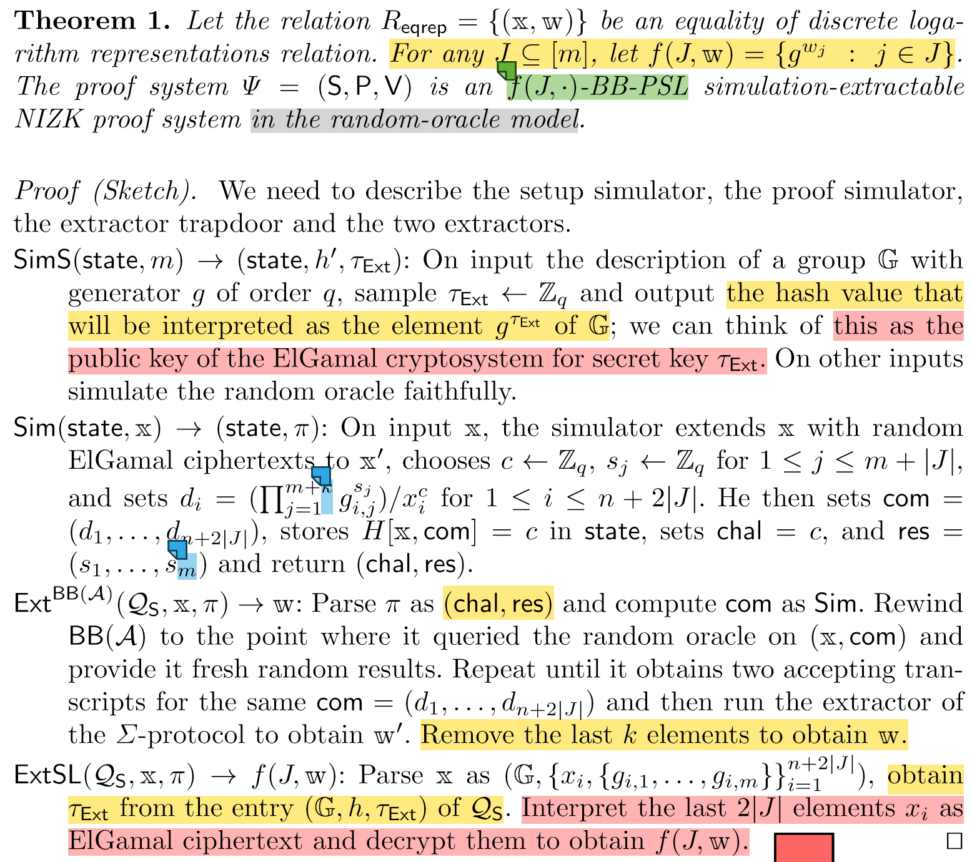
Preliminaries

Slide 20
Content
Introduction and Contributions
Preliminaries
Homomorphic Enough Encryption
f -Blueprint

Slide 21
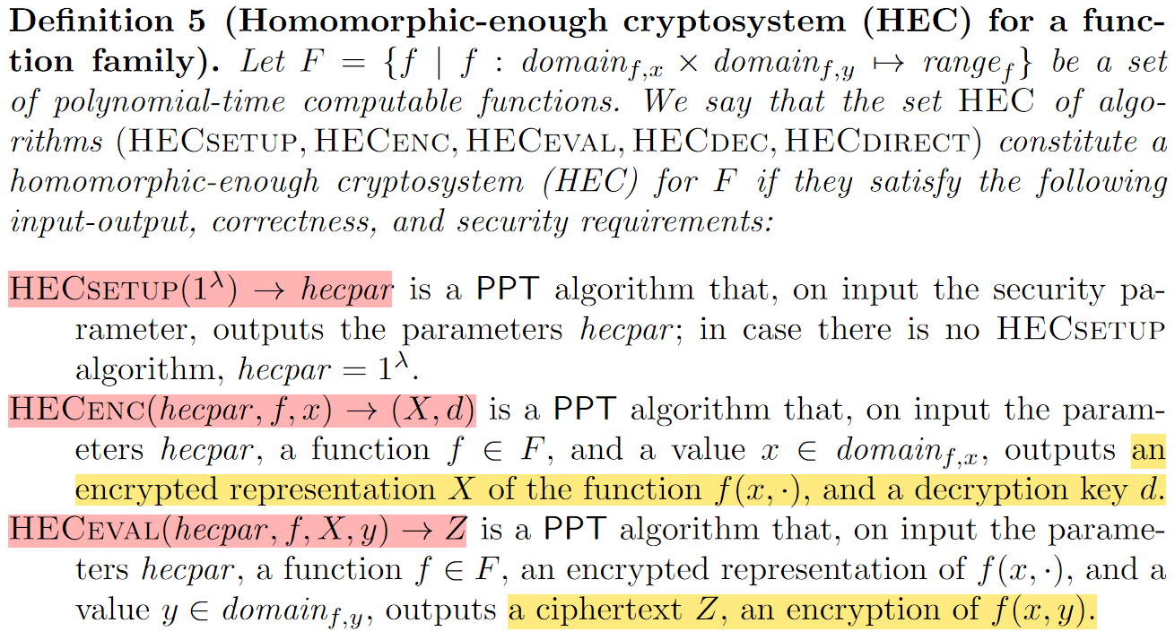
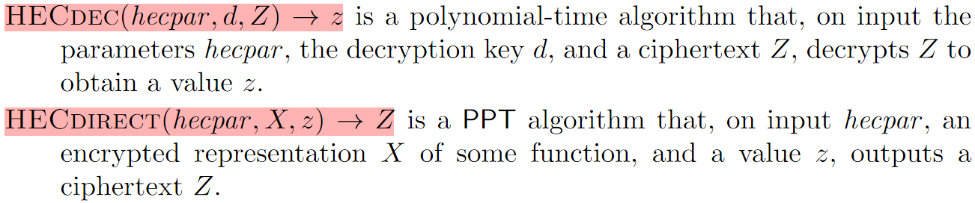

Homomorphic Enough Encryption
函数$f$有2个输入变量

Slide 22
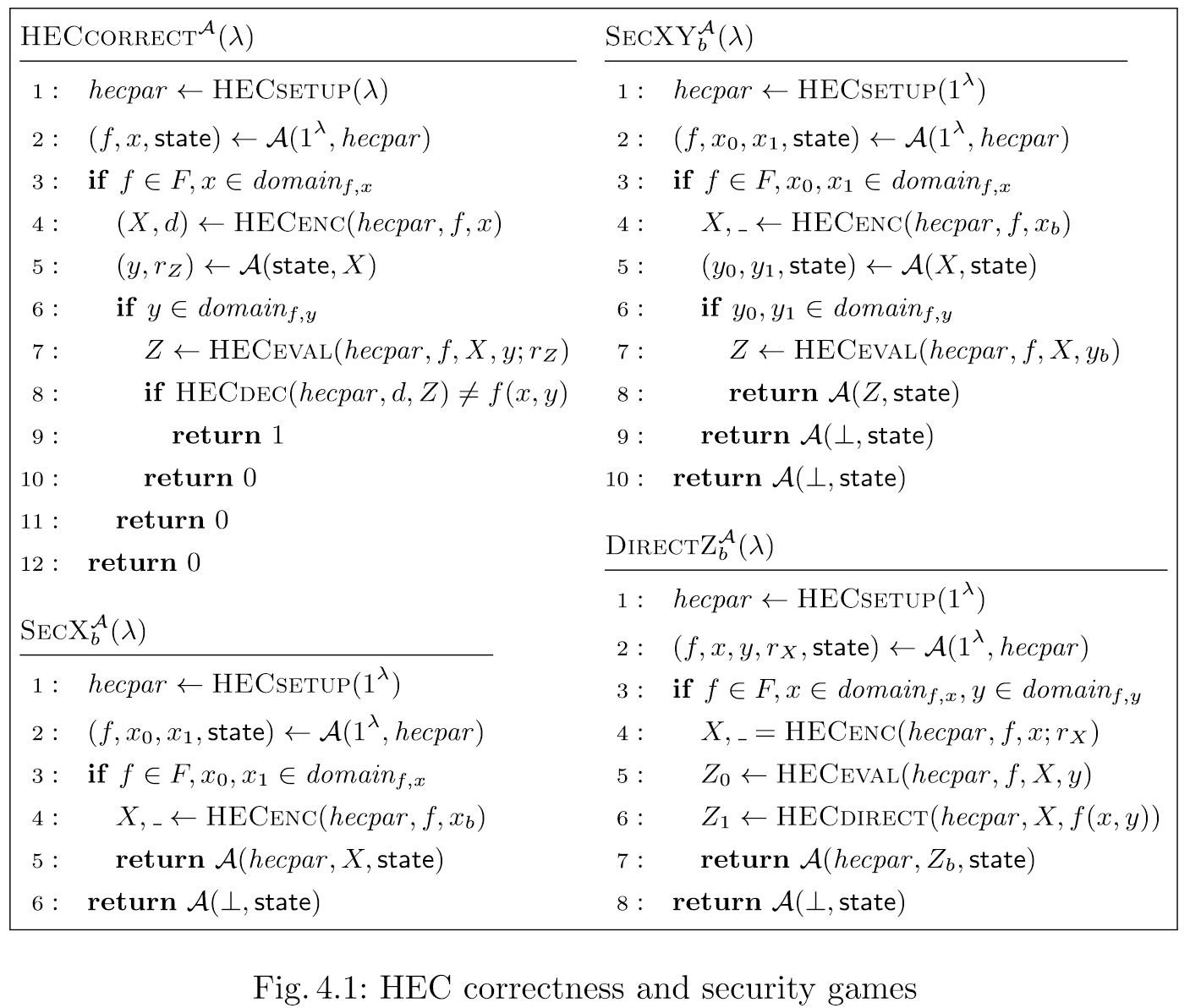
Homomorphic Enough Encryption
Correctness：
从正确生成的Z中HECdec解密不出f(x, y)的概率很小。
Security of x and y from third parties：
密文Z和X不会泄露f(x, y)
Security of x：
密文X不会泄露x
Security of DirectZ：
HECdirect的输出与 HECeval 的输出不可区分

Slide 23
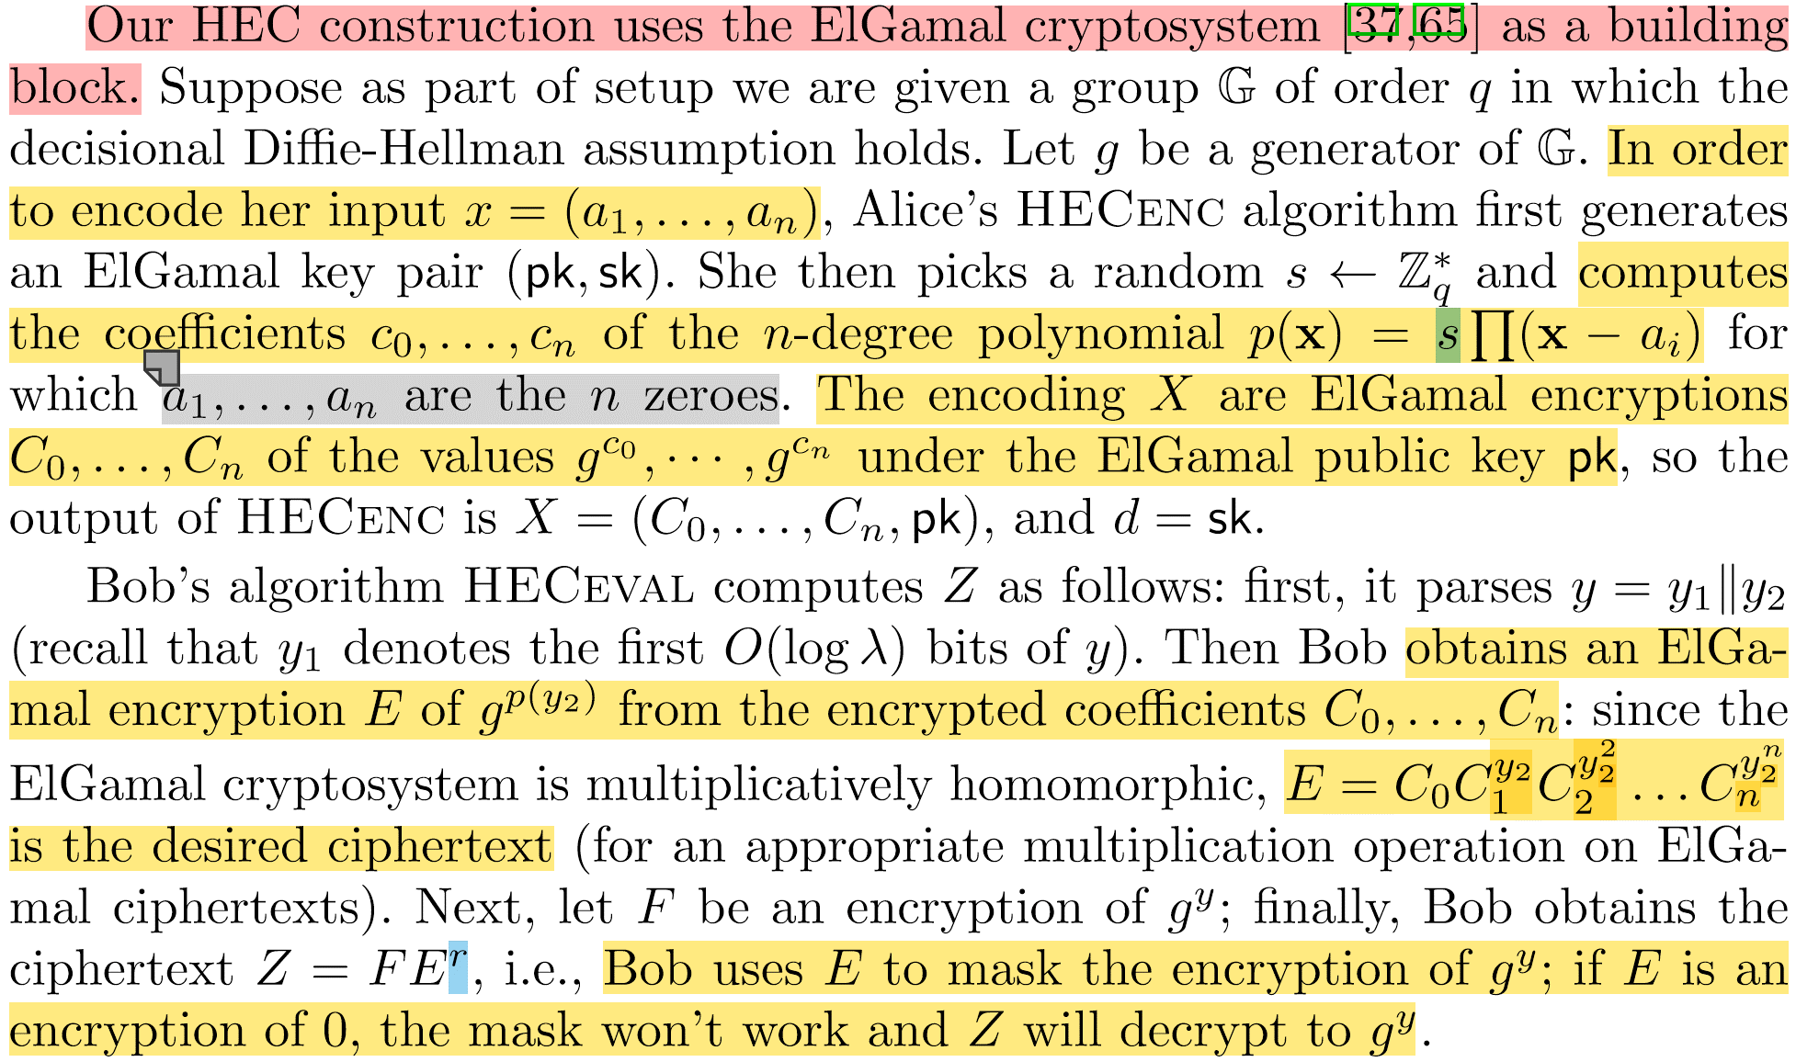
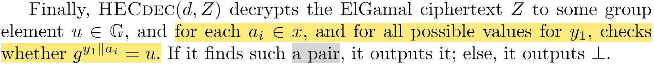
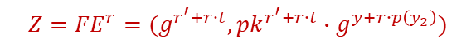
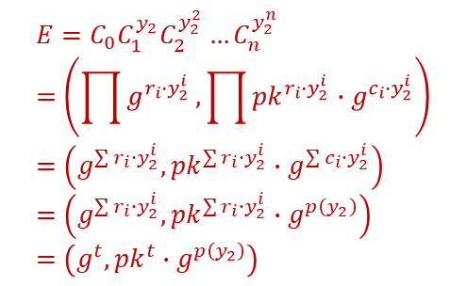
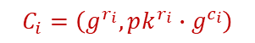
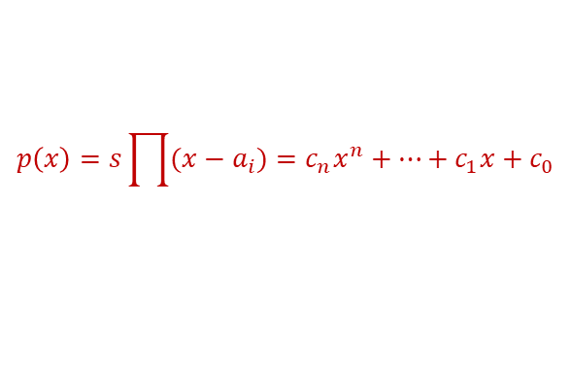
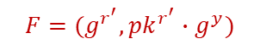
HEC from the ElGamal Cryptosystem
Auditor: Alice
User: Bob
Alice使用HECenc编码监视列表
Bob使用HECeval生成一个托管Z
Alice可以从托管Z中解密得到关于Bob秘密的函数值
$$p\left(x\right)=s\prod{(x−a_{i})}=c_{n}x^{n}+…+c_{1}x+c_{0}$$
$$C_{i}=\left(g^{r_{i}},pk^{r_{i}}∙g^{c_{i}}\right)$$
$$E=C_{0}C_{1}^{y_{2}}C_{2}^{y_{2}^{2}}…C_{n}^{y_{2}^{n}}=\left(\prod{g^{r_{i}∙y_{2}^{i}}},\prod{pk^{r_{i}∙y_{2}^{i}}∙g^{c_{i}∙y_{2}^{i}}}\right)=\left(g^{\sum{r_{i}∙y_{2}^{i}}},{pk}^{\sum{r_{i}∙y_{2}^{i}}}∙g^{\sum{c_{i}∙y_{2}^{i}}}\right)=\left(g^{\sum{r_{i}∙y_{2}^{i}}},{pk}^{\sum{r_{i}∙y_{2}^{i}}}∙g^{p\left(y_{2}\right)}\right)=\left(g^{t},{pk}^{t}∙g^{p\left(y_{2}\right)}\right)$$
$$F=(g^{r^{′}},pk^{r^{′}}∙g^{y})$$
$$Z=FE^{r}=(g^{r^{′}+r∙t},{pk}^{r^{′}+r∙t}∙g^{y+r∙p\left(y_{2}\right)})$$

Slide 24
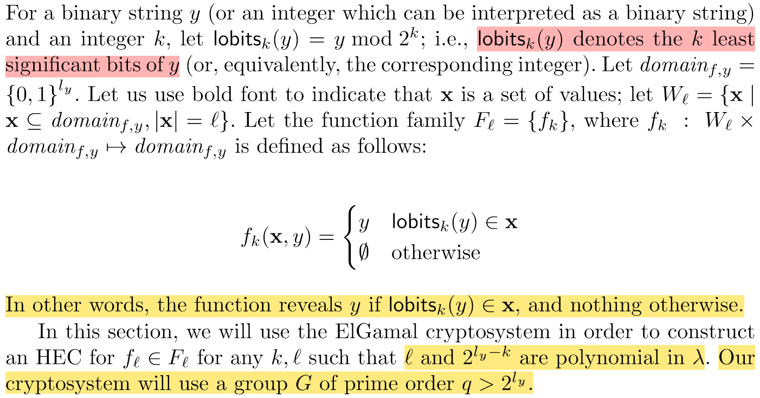
HEC from the ElGamal Cryptosystem

Slide 25
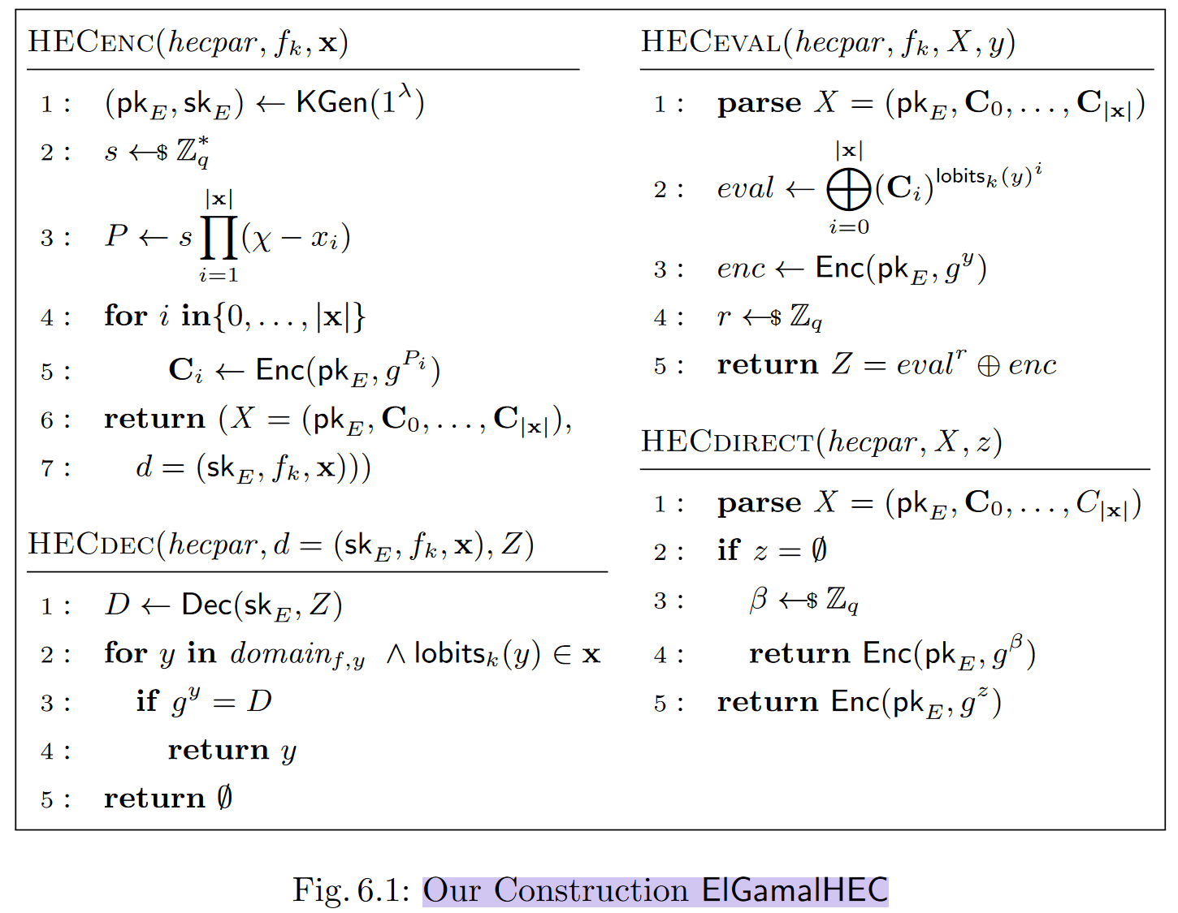
HEC from the ElGamal Cryptosystem
Notes:
这个地方拆开写一写公式。

Slide 26
Content
Introduction and Contributions
Preliminaries
Homomorphic Enough Encryption
f -Blueprint

Slide 27


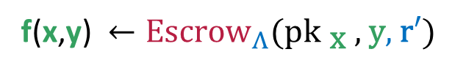
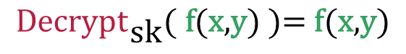

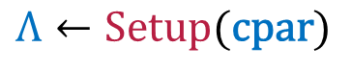
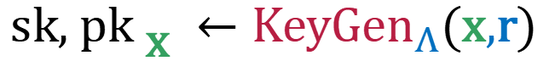

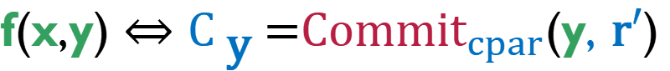

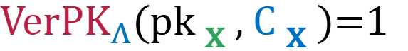
The Full Syntax of f -Blueprint Scheme
Auditor
$$Λ←\text{Setup}\text{(}\text{cpar}\text{)}$$
$$\text{sk}\text{, }\text{p}{\text{k}}_{ \text{x} }←{\text{KeyGen}}_{Λ}\text{(}\text{x}\text{,}\text{r}\text{)}$$
$${\text{Decrypt}}_{\text{sk}}\text{(} \text{f}\text{(}\text{x}\text{,}\text{y}\text{)} \text{)= }\text{f}\text{(}\text{x}\text{,}\text{y}\text{)}$$
$${\text{VerPK}}_{Λ}\text{(}\text{p}{\text{k}}_{ \text{x} }\text{, }{\text{C}}_{ \text{x} }\text{)=1}$$
${\text{C}}_{ \text{x} }\text{=}{\text{Commit}}_{cpar}$(x,r) $⇔$ $\text{p}{\text{k}}_{ \text{x} }$
User
Verifier
User
f(x,y)$←{\text{Escrow}}_{Λ}\text{(}\text{p}{\text{k}}_{ \text{x} }\text{, }\text{y}\text{, }\text{r}′\text{)}$
$${\text{VerEscrow}}_{Λ}\text{(}\text{p}{\text{k}}_{ \text{x} }\text{,} \text{f}\text{(}\text{x}\text{,}\text{y}\text{)}\text{, }{\text{C}}_{ \text{y}} \text{)=1}$$
f(x,y) $⇔{\text{C}}_{ \text{y} }\text{=}{\text{Commit}}_{cpar}$(y, $\text{r}′$)
Notes:
x could be a list and y could be the user’s attributes in a credential system.

Slide 28
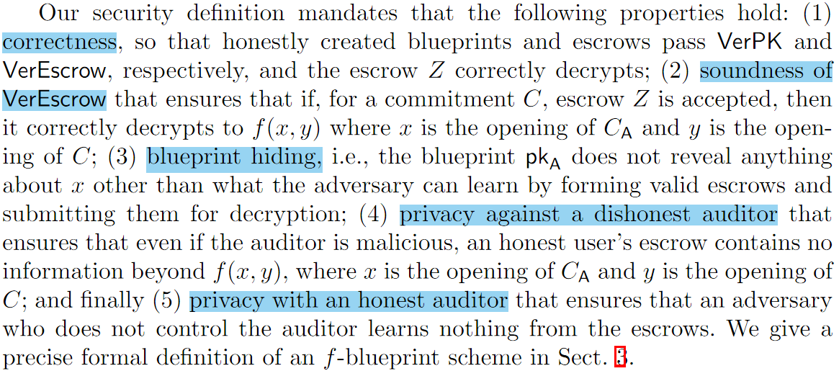
Security Definition
Notes:
pkA just reveals that x is a valid first argument to f

Slide 29
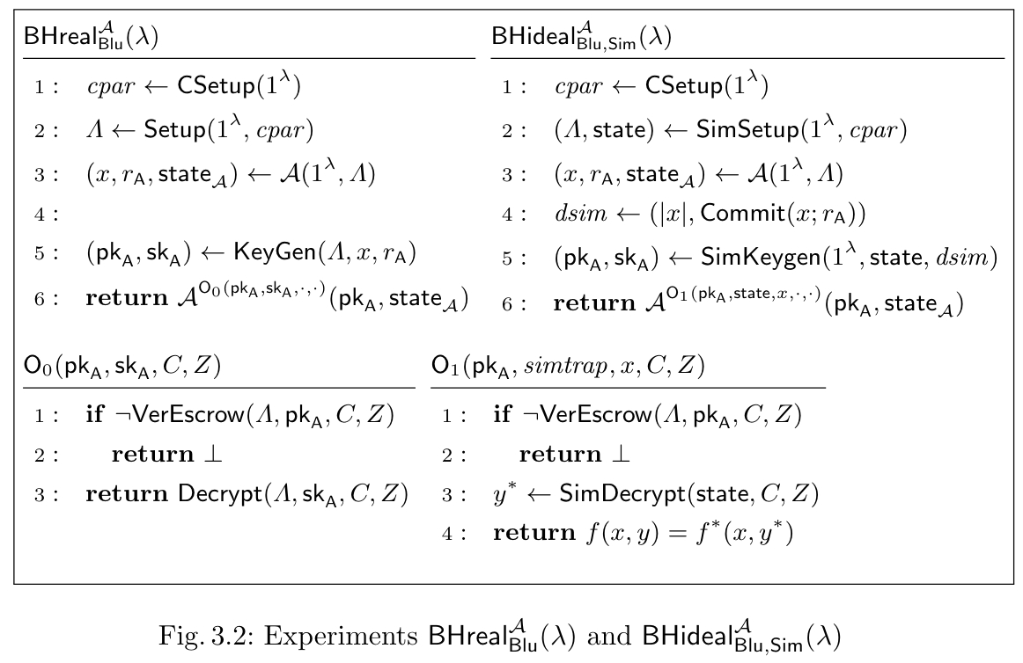
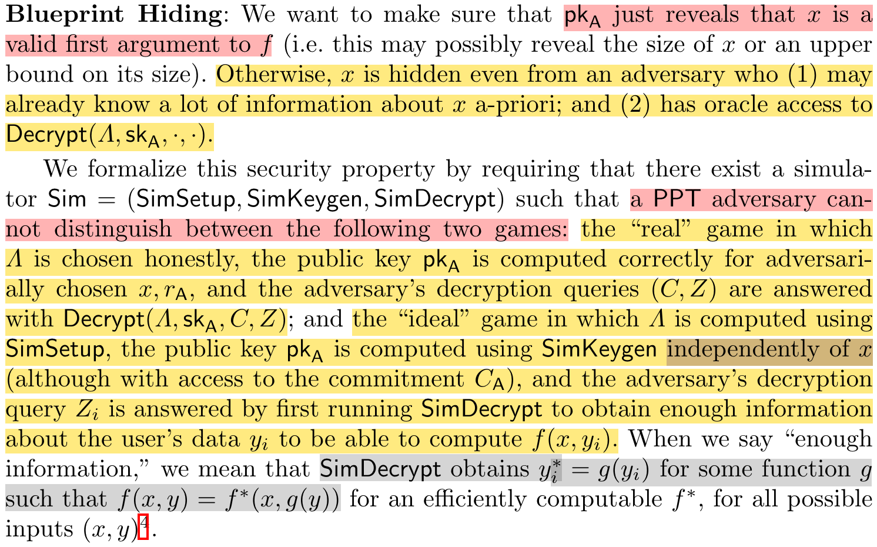
Security Definition
Notes:
pkA just reveals that x is a valid first argument to f

Slide 30
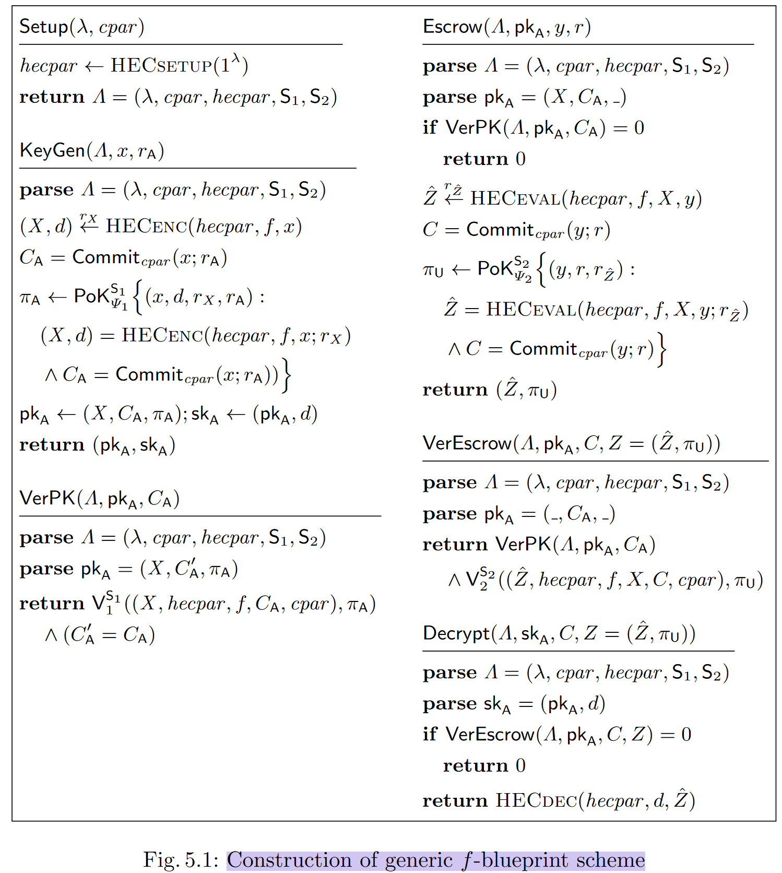
A Generic f-Blueprint scheme from HEC
a commitment scheme,
a homomorphic-enough cryptosystem, two NIZK proof systems as building blocks.
indeed Z was computed correctly for the given pkA and C
indeed pkA was computed correctly for the given warrants data commitment CA.
Notes:
即使是恶意auditor也无法创建与未经授权的输入 x 相对应的blueprint。

Slide 31
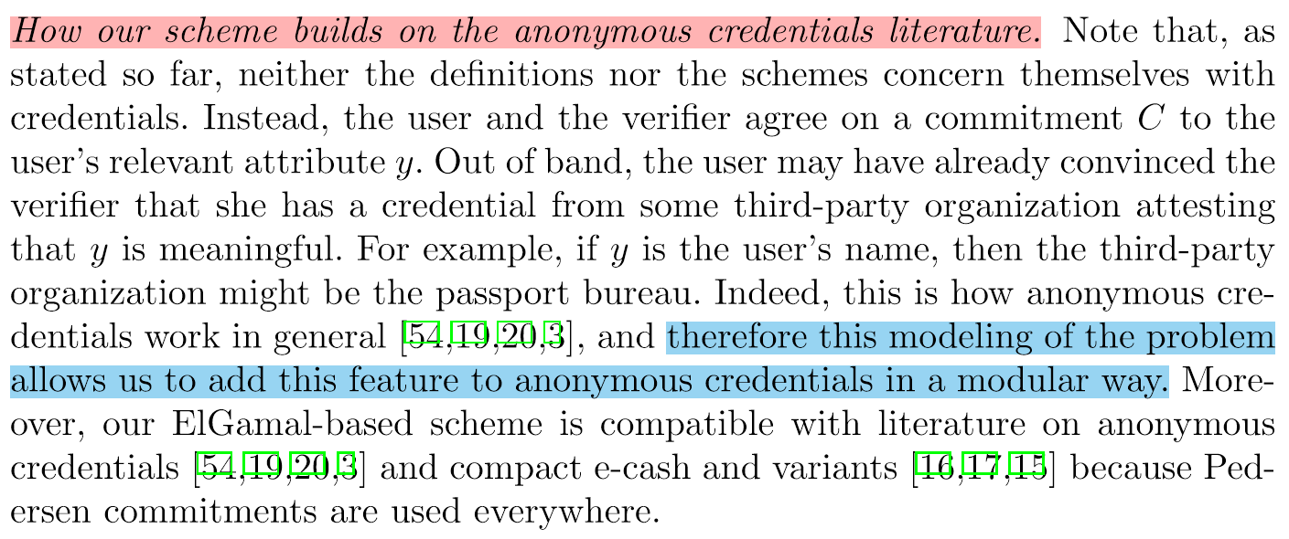
How to integrate with anonymous credentials

Slide 32
THANK YOU!
Questions?

